Slide 1
OUTPUT
DEVICES
By
Pawan Mahadu Sarule
Class : FYBCA(Sci)

Slide 2

INTRODUCTION
Output Devices are used to receive information from the computer either in Softcopy or Hard Copy.

Slide 3

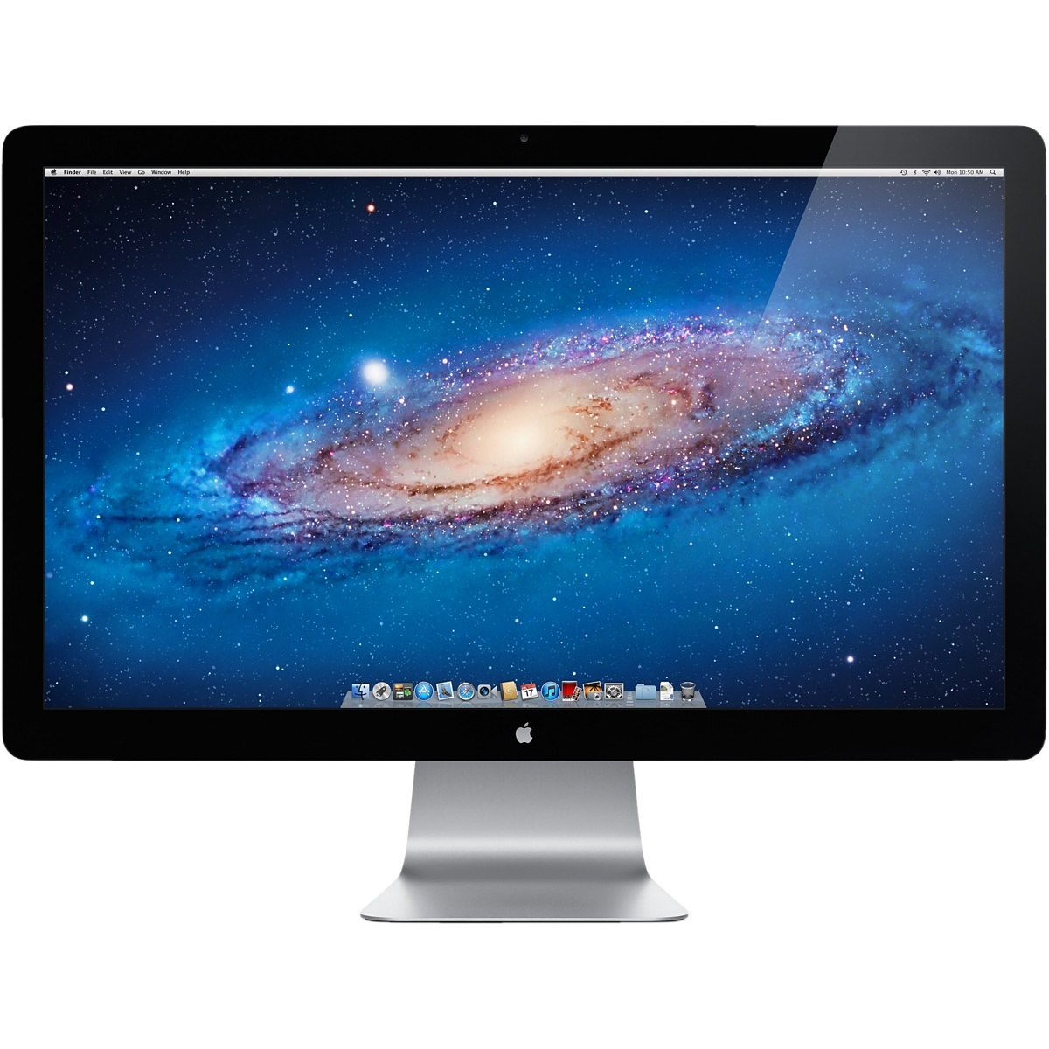
MONITOR
Monitor was invented in 1897 by Karl Ferdinand Braun.
A computer monitor or a computer display is an electronic visual display for computers.
A computer monitor is an electronic device that shows pictures for computers. Monitors often look similar to televisions.
There are three types of monitor:
C.R.T Monitor
L.C.D Monitor
L.E.D Monitor MONITOR

Slide 4


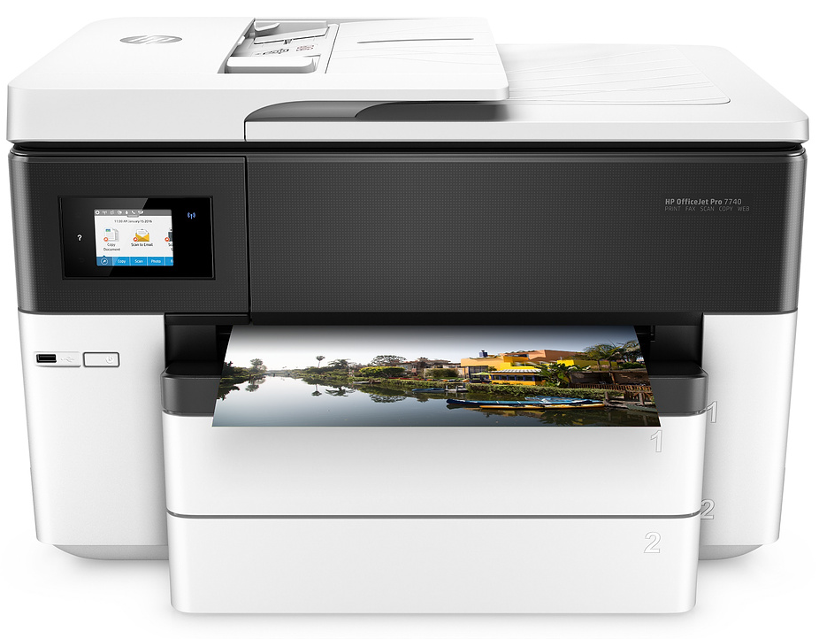
PRINTER
Printer is a peripheral device that produces a physical copy or hard copy of the computer’s output.”
Types of Printer :
Impact Printers
Dot Matrix Printer
Daisy Wheel Printer
Non Impact Printers
Laser Printer
Ink-Jet Printer
Thermal Printer

Slide 5

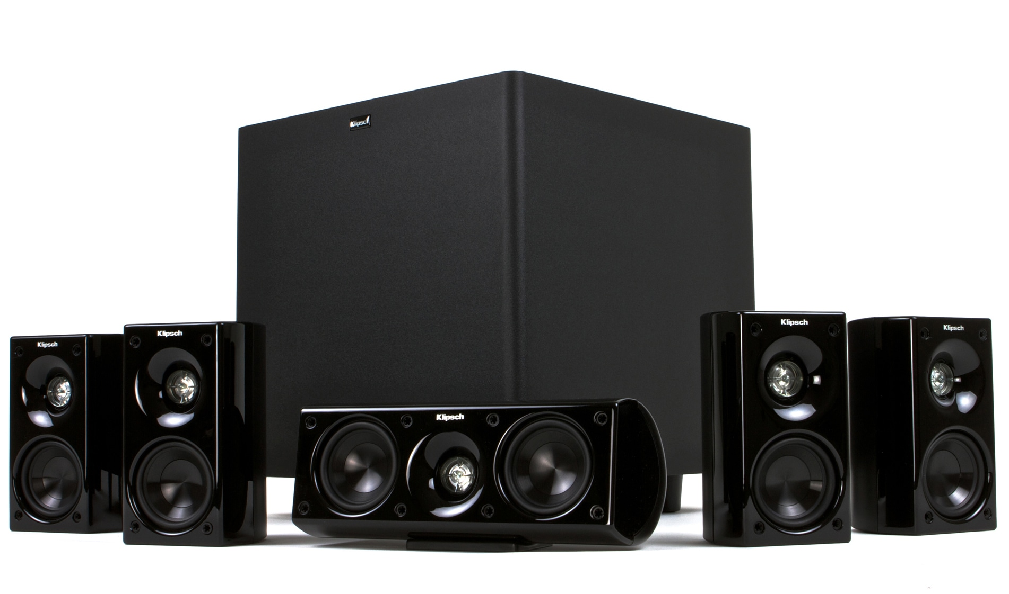
AUDIO OUTPUT DEVICE
The term “Audio Output Device" refers to any device that attaches to a computer for the purpose of playing sound, such as music or speech. The term can also refer to a computer sound card.
Types Of Audio Output Device:
Speakers
Headphones
Sound Card

Slide 6
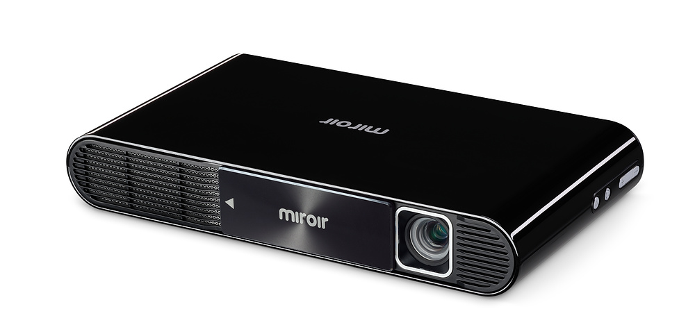
PROJECTOR
Projector was invented by Charles Francis Jenkins.
A projector or image projector is an optical device that projects an image (or moving images) onto a surface, commonly a projection screen.

Slide 7



